Slide 2
Welcome to Socials 8
Here are the rules…

Slide 3
The Rules
Rule #1
These rules aren’t 100% in stone, there is some “wiggle room”
Rule #2
The “wiggle room” is more for my reinterpretation/application of the rules not yours…
Rule #3
We follow a seating plan… end of story (helps me learn all your names, also a great way to control the class)
The seating plan will evolve monthly if I think we need a swap; some of you might find yourself moved sooner, more on that later…
BUT, because this is my first seating plan with you, I’ll make a deal…
Rule #4
Don’t allow yourself to fall behind – I will refer you to the office/give you an “Incomplete” if I have to… Lunch time “work sessions” are used OFTEN…

Slide 4
Rules.2
Rule #5 – work habits… this is where “we” get down to business
Daily you are expected to complete the worksheets that I give you
Daily I will check previous day’s worksheets off for completion this will either be in daily review or random checks…
If you do not have all of the required work done on a daily basis there will be consequences:
3 strikes = homework club (after school DT)
4th strike = office referral

Slide 5
Rules.3
Rule #6– Rules dealing with Unit Tests & Retest
Retests will not always be an option, but if I do have a retest, certain criteria must be met:
If you do not complete your Vocab etc., you will not be able to do the retest should you desire
Retests must be done within 3 days of us reviewing the unit test
I will have sign up sheets & dates set up for you
Remember all worksheets must done in order to write the test & the retest rule that is associated with that…

Slide 6
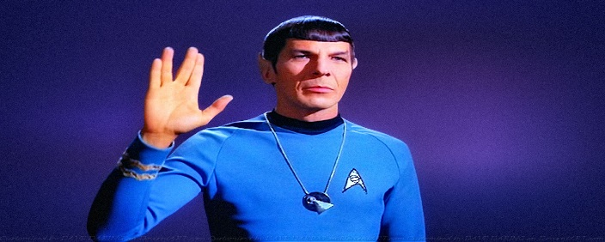
Rules.4
Rule #7 – Classroom environment & the tone that will be…
Daily I will lecture, some days for 10 minutes, some days for 30, rarely ever more than that
You will then get time to work on the assigned worksheets (prevents homework, allows for questions to be asked)
“If” you are found to be off task, this is the chain of events:
First warning, this is your freebie
Second warning, you will be moved to the side of the class and/or a lunch time DT
Third warning, you will be asked to leave the class, the office will then deal with things
The following day you will sit at the side of the class, only to return to your normal seat if you earn it
This chain of events can be altered!
I, and your classmates do not have the time to put up with “goof offs”…
“The needs of the many overweigh the needs of the few…or the one”
- Spock (Star Trek II, Wrath of Khan)

Slide 7
Rules wrap up
Now that you know the rules, remember this:
I do not want to be an enforcer of the rules, I want to teach you Socials 8; I enjoy this subject and will try to ensure that you do as well…
Part of teaching and learning should involve moments of fun, I like having fun, and at the same time I have a job to do – don’t wreck the mix of fun and teaching that I see us being able to have…
Come to class prepared to work and learn – I do not accept the status quo, I want to be a successful teacher, but most importantly I want you to be successful students…
I will go the extra mile for you, I need you to do the same for yourself and your classmates…
At the end of the day, my Goal is to have a class of
Hardworking Students…
This involves:
Effort
Consistency
Respect
A “soon to be normal” sense of Rigor & Work Ethic

Slide 8
Marking Plan
There is a catch…
Your Semester
Marking formula for Socials 8
Classroom Discussion & Quizzes: 5%
Daily discussion & potential quizzes (2.5% per term)
Assignments: 40%
Includes all work I collect/mark
Tests & Quizzes 35%
Straight forward, quizzes are a “maybe”
Final Exam: 20%
This will include all we do in Socials 8
Total: 100%
2
Extra
2%*...
1
5 Unit
Tests
1 Final
Exam
~30
Assignments

