Slide 1
You & The Core Competencies
An Introduction and Personal Assessment

Slide 2
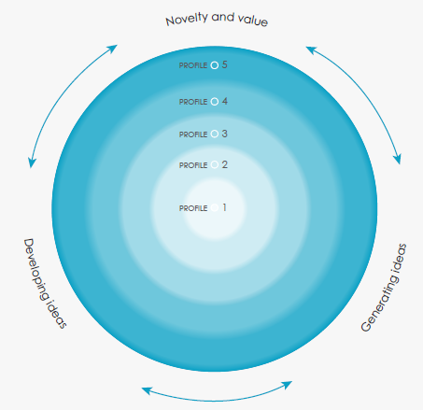
Creative thinking is deeply cooperative.
New thoughts and concepts are built on combinations of existing thoughts and concepts.
The ideas available as raw material for creative thinking depend on previous experiences and learning, as wellas one’s cultural legacy.

Slide 3
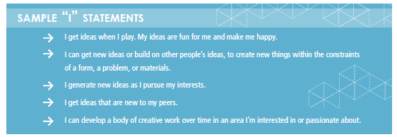
Creative Thinking Idea #1: Novelty and Value.
Students get creative ideas that are both novel and have value.
There are degrees of novelty—an idea may be new to that student or it may be new to their peers.
It may be novel for their age group, or it may be novel to a larger community. It may be new in a particular context or absolutely new.
The idea or product may also have value in a variety of ways and contexts:
It may be fun
It may provide a sense of accomplishment
It may solve a problem
It may be a form of self-expression
It may provide a new perspective that influences how people think or act.
An idea can have an impact on the individual student, classmates, a larger group of peers, in one’s community, or on a global level.

Slide 4
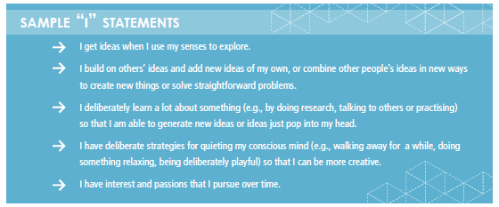
Creative Thinking Idea #2: Generating Ideas.
Students may generate creative ideas as a result of free play, engagement with other’s ideas, or interest or passion.
Think of when an idea “pops” into your head…
However, students can also become aware of, and use, ways to help their unconscious minds generate ideas.
e.g., by learning a lot about something of interest.
Also, by providing development time for the unconscious to work, and quieting the outside world ideas can be generated.
e.g., by doing relaxing or automatic activities. (LIKE NOT BEING ONLINE!!!)

Slide 5
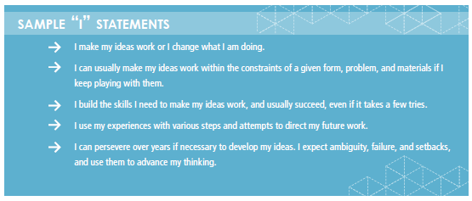
Creative Thinking Idea #3: Developing Ideas.
After students get creative ideas, they evaluate them, decide which ones to develop, refine them, and work to realize them in some way.
This process of developing ideas may require building the necessary skills, sustaining perseverance, and using failure productively over time.
It may also require generating additional creative ideas to come up with solutions to problems along the way.
The ability to think on the fly.

Slide 6
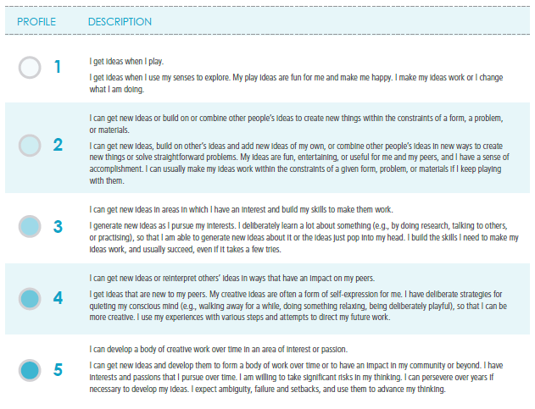
Where do you fall on the Creative Thinking Competency?

Slide 7
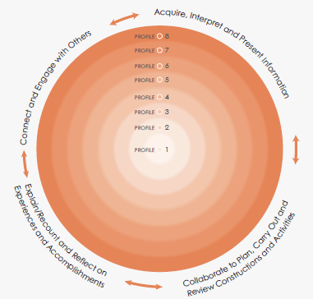
Communication competency encompasses the set of abilities that students use to exchange information, experiences, and ideas, to explore the world around them.
Communication competency provides a bridge between students’ learning, their identity and relationships, and the world in which they interact.

Slide 8
Communication Idea #1: Connect and engage with others.
Students engage in informal and structured conversations where they listen, contribute, develop understanding and relationships, learn to consider diverse perspectives, and build consensus.
Examples include literature circles, book clubs, blogs, and small group discussions/decision making/informal debating.

Slide 9
Communication Idea #2: Acquire, interpret and present information.
Students inquire into topics that interest them, and topics related to their school studies. They present for many purposes and audiences; their work often features media and technology.
Examples include “show and tell,” explaining a concept, sharing a Power Point presentation about a research/inquiry topic, and creating a video proposal.

Slide 10
Communication Idea #3: Collaborate to plan, carry out, and review constructions and activities.
Students work together to accomplish goals, either face to face, or through digital media.
Examples include planning a construction, inquiry or performance, solving a problem, conducting an inquiry, and working together on community projects.

Slide 11
Communication Idea #4: Explain/recount and reflect on experiences and accomplishments.
Students tell about their experiences—especially their learning experiences—and reflect, and share what they learned.
Examples include presentations of learning, self-assessment, and receiving/offering feedback.

Slide 12
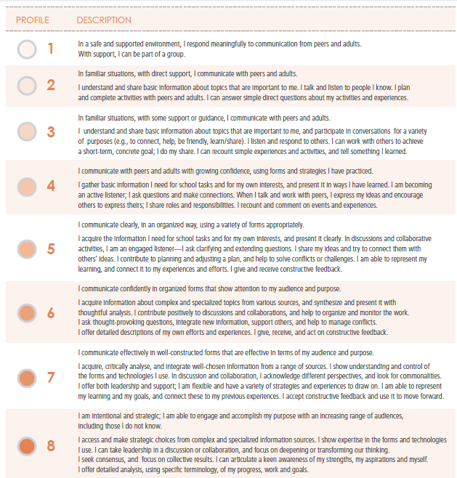
Where do you fall on the Communication Competency?

Slide 13
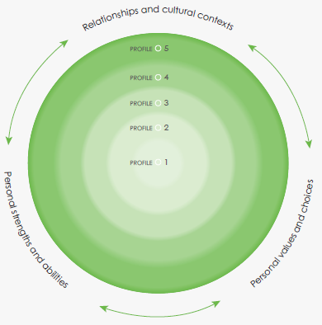
A positive personal and cultural identity is the awareness, understanding, and appreciation of all the aspects that contribute to a healthy sense of oneself.
It includes awareness and understanding of one’s family background, heritage(s), language(s), beliefs, and perspectives in a pluralistic society.
Students who have a positive personal and cultural identity value their personal and cultural narratives, and understand how these shape their identity.

Slide 14
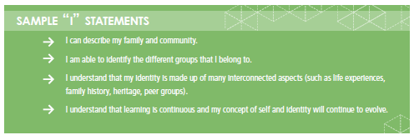
Positive Personal & Cultural Identity Idea #1: Relationships and cultural contexts.
Students understand that their relationships and cultural contexts help to shape who they are.
“Culture” is meant in its broadest sense, including identifiers such as ethnicity, nationality, language, ability, sex/gender, age, geographic region, sexuality, and religion.
Students define themselves in terms of their relationship to others and their relationship to the world (people and place) around them.

Slide 15
Positive Personal & Cultural Identity Idea #2: Personal values and choices.
Students define what they value. They understand how what they value has been influenced by their life experiences.
They identify ways in which what they value helps to shape their choices in all contexts of their lives.

Slide 16
Positive Personal & Cultural Identity Idea #4: Personal strengths and abilities.
Students acknowledge their strengths and abilities, and explicitly consider these as assets that can help them in all aspects of their lives.
Students understand that they are unique and are a part of larger communities.
They explain how they are using their strengths and abilities in their families, their relationships, and their communities.

Slide 17
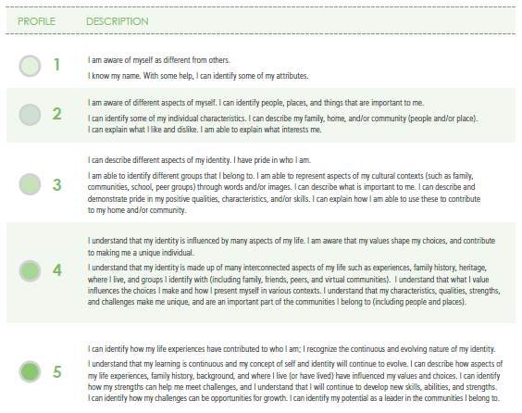
Where do you fall on the Positive Personal and Cultural Identity Competency?

